Slide 1

COMPUTERLESS COMPUTING GAMES

Slide 2
COURSE TIMELINE
Programming Projects with Lua
Roblox Studio Basics
Constraints Pt 1
Constraints Pt 2
Intro to Lua
Parameters
Loops & Conditionals
Functions
W1
W2
W3
W4
W5
W6
W7
W8

Slide 3

Edmodo
Resource Hub
Slides
Learning Material
Exercises/ Assignments / Quizzes
Tutorial Videos
WHEN TO CHECK
FRIDAY AFTERNOON EVERY WEEK
Communication
Directly message teachers
Post Questions
Post Screenshots of your work

Slide 4

Cipher Hunt
Find the secret agent!

Slide 5
OPERATION: Find the secret agent!
You’ve found a secret folder, it has some funny documents!
They’re all jiberish and and there are a lot of emoji!
You seem to have a:
Caesar Cipher
Vigenere Cipher
Substitution Cipher
TYPES OF CONSTRAINTS
Notes:
Go through real life examples (see worksheet Wk3)

Slide 6


OPERATION: Find the secret agent!
They seem to be linked!
Crack the Caesar to get a hint to the Vigenere
The Vigenere seems to have some coloured marks. Maybe they’ll be useful!
You’ve got a handy, colourful frequency chart and a lot of emoji! There are some highlighted patches in the substitution cipher!
Find the secret agent and tell them a password!
TYPES OF CONSTRAINTS
?
Notes:
Go through real life examples (see worksheet Wk3)

Slide 7
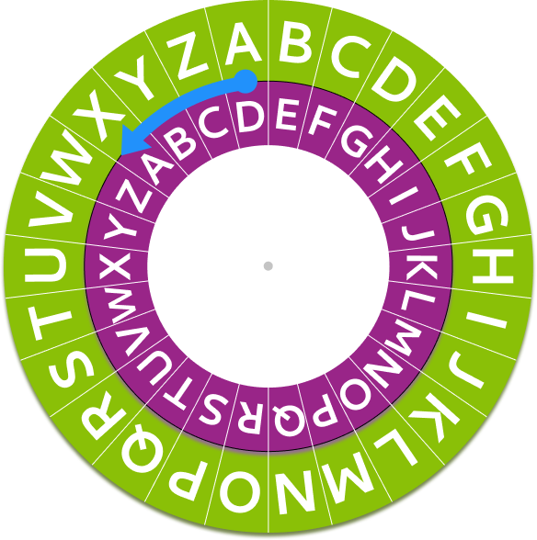
Cracking Caesar Ciphers!
Caesar Ciphers allow us to encrypt and decrypt messages
ZAC → CDF
FRGH → CODE
But how do we decrypt if we don’t know the key?
There are only 2 words that are only a single letter long!
Look for letters that appear a lot! Letters from most to least frequently used are:
e t a o i n s h r d l c u m w f g y p b v k j x q z
Notes:
Go through real life examples (see worksheet Wk3)

Slide 8
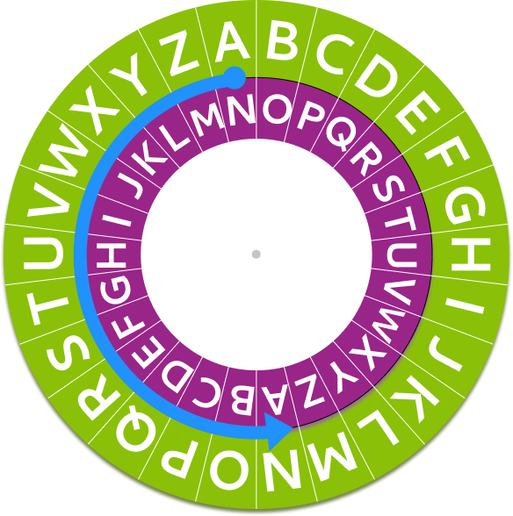
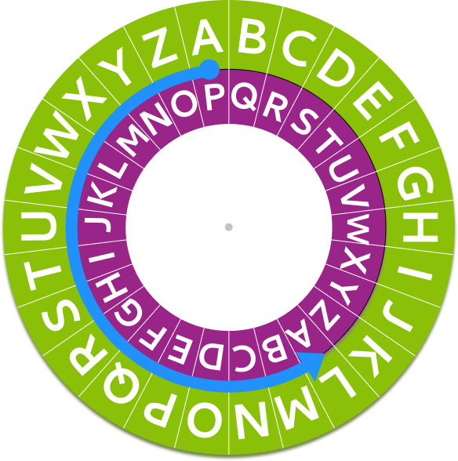
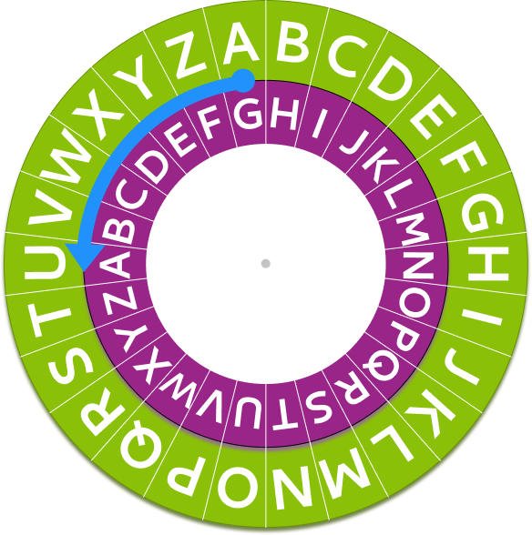
Vigenere Ciphers!
Vigenere ciphers are like several Caesar ciphers combined.
Instead of one rotation key number we have a keyword. eg: “gpn”.
“gpn” is a way of telling you the different rotations, 6, 15 and 13.
Keyword
g | p | n
6 | 15 | 13
The letter a is 0
Notes:
Go through real life examples (see worksheet Wk3)

Slide 9
Vigenere Ciphers!
We rotate through the different letters/keys of the cipher! So we use different ones on different letters.
To decrypt a Vigenere Cipher it’s just like decrypting several Caesar ciphers!
Do the negative of the key and rotate your cipher wheel backwards.
Keyword
g | p | n
6 | 15 | 13
z | w | v | y |  | x | f |  | g |  | h | r | i | g | r | z |  | b | r | y | h | n | m | t
↓ | ↓ | ↓ | ↓ |  | ↓ | ↓ |  | ↓ |  | ↓ | ↓ | ↓ | ↓ | ↓ | ↓ |  | ↓ | ↓ | ↓ | ↓ | ↓ | ↓ | ↓
g | p | n | g |  | p | n |  | g |  | p | n | g | p | n | g |  | p | n | g | p | n | g | p
-6 | -15 | -13 | -6 |  | -15 | -13 |  | -6 |  | -15 | -13 | -6 | -15 | -13 | -6 |  | -15 | -13 | -6 | -15 | -13 | -6 | -15
↓ | ↓ | ↓ | ↓ |  | ↓ | ↓ |  | ↓ |  | ↓ | ↓ | ↓ | ↓ | ↓ | ↓ |  | ↓ | ↓ | ↓ | ↓ | ↓ | ↓ | ↓
t | h | i | s |  | i | s |  | a |  | s | e | c | r | e | t |  | m | e | s | s | a | g | e
Notes:
Go through real life examples (see worksheet Wk3)

Slide 10
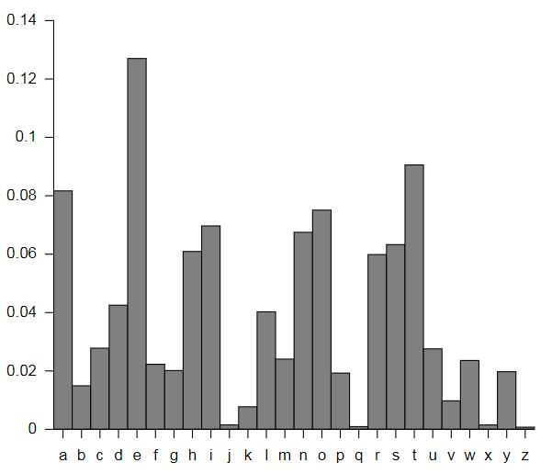
Substitution Ciphers!
The chart to the right shows the frequency distribution of different letters in english texts.
Not all texts will have the same distribution. But this gives you some hints about which are popular in general!
Letters from most to least frequently used are:
e t a o i n s h r d l c u m w f g y p b v k j x q z
Notes:
Go through real life examples (see worksheet Wk3)

Slide 11
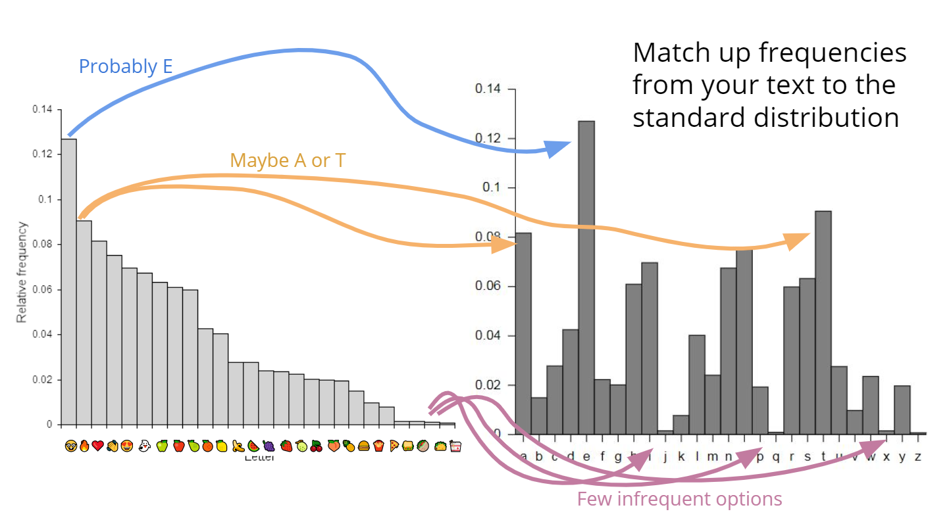
Substitution Ciphers!
Notes:
Go through real life examples (see worksheet Wk3)

Slide 12
MISSION DEBRIEF

Slide 13
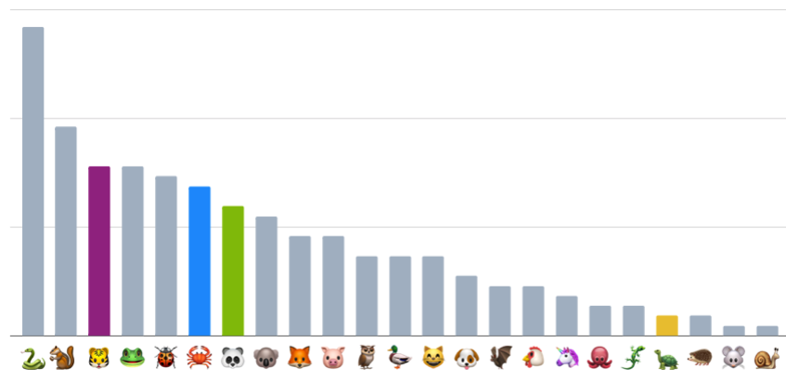
THE MISSION
Our intel informs us that the collection of emoji on the next page contains the name of a secret agent and a password.
Work out what the emoji translates to and find the secret agent and tell them the password.
The following is a chart showing the frequency of the appearance of emoji in the text. You can compare this to the frequency of letter use in english we showed you earlier.
For some reason some of the columns in the chart are coloured…

Slide 14
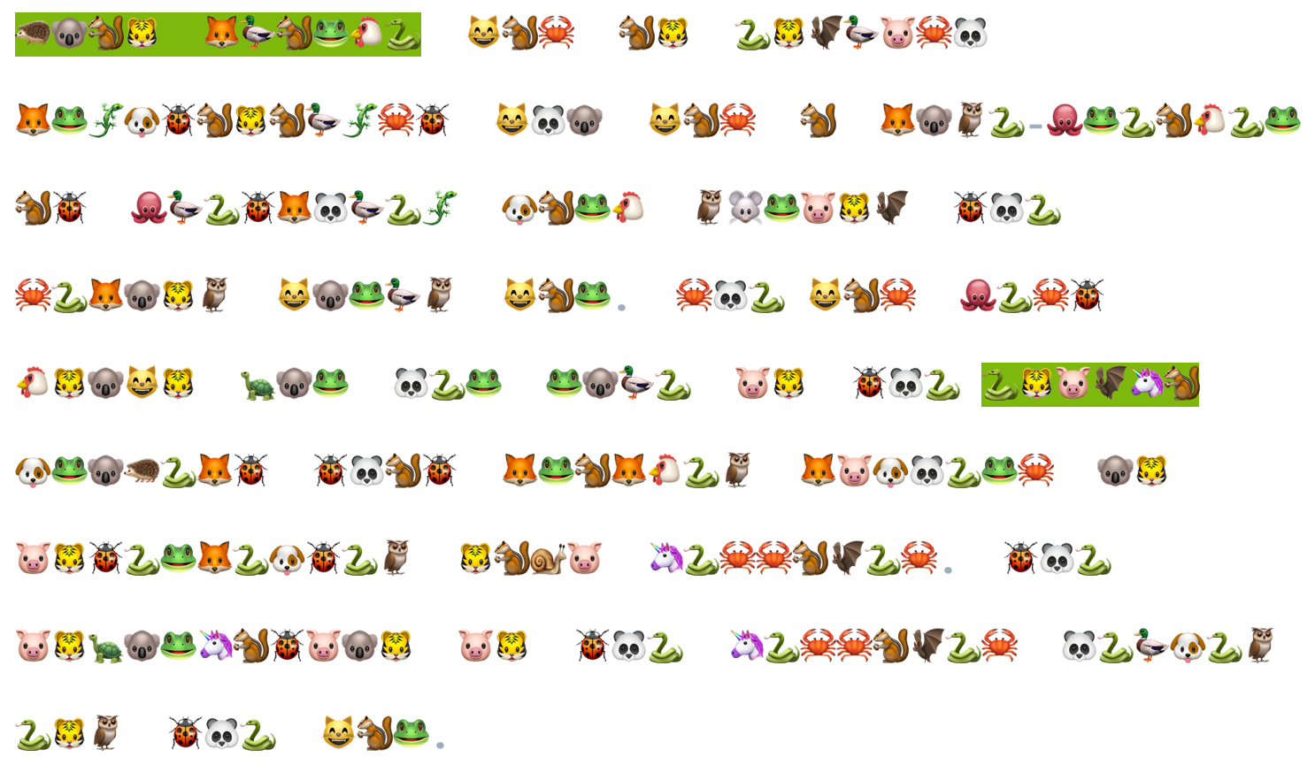
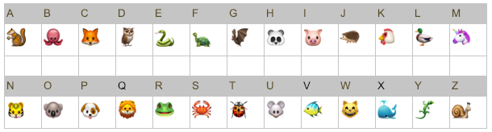
SUBSTITUTION CIPHER

Slide 15
SOLUTION
Joan Clarke was an English cryptanalyst who was a code-breaker at Bletchley Park during the Second World War. She was best known for her role in the Enigma project that cracked ciphers on intercepted Nazi messages. The information in the messages helped end the war.
Secret Agent Name: Joan Clarke
Password: enigma

Slide 16


Building Roads on a Budget

Slide 17
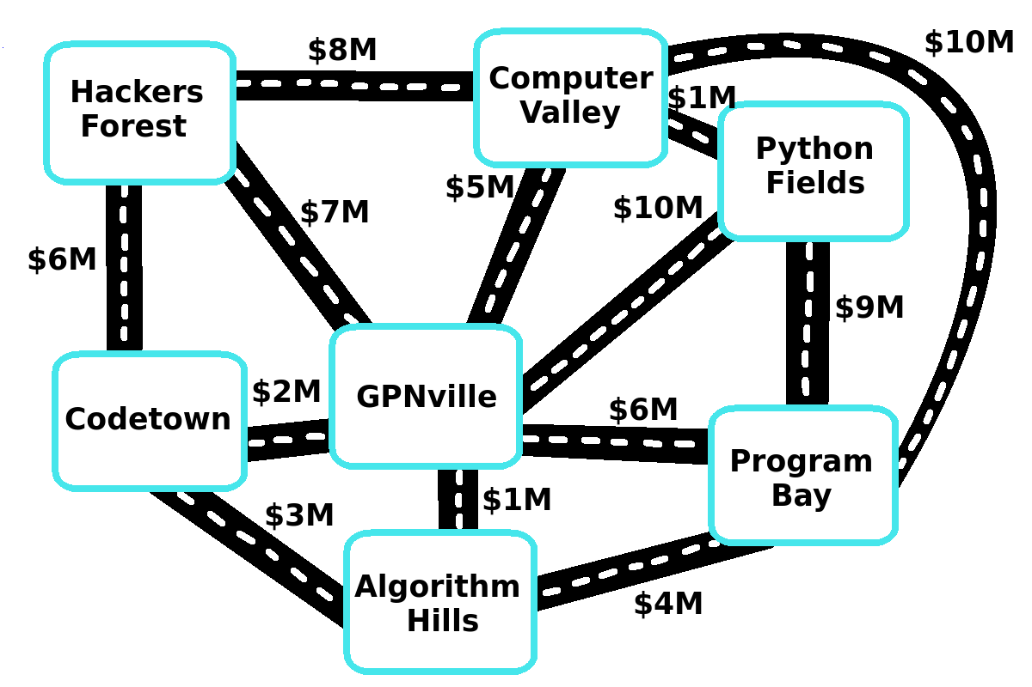
Building Roads on a Budget
We’re building a new city and it’s your job to build the majors roads between all the suburbs.
There’s a bunch of roads to choose from it’s your job to make sure all the suburbs are connected for the lowest cost!
Code
Create HQ

Slide 18
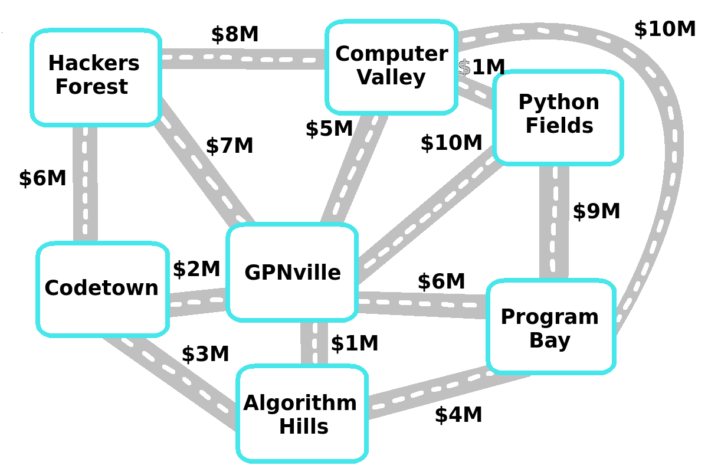
Our Road Building Algorithm
Here’s how:
Find the cheapest road
Build it if it connects 2 areas that couldn’t get to each other before
Repeat until everything connects!
Code
Create HQ

Slide 19
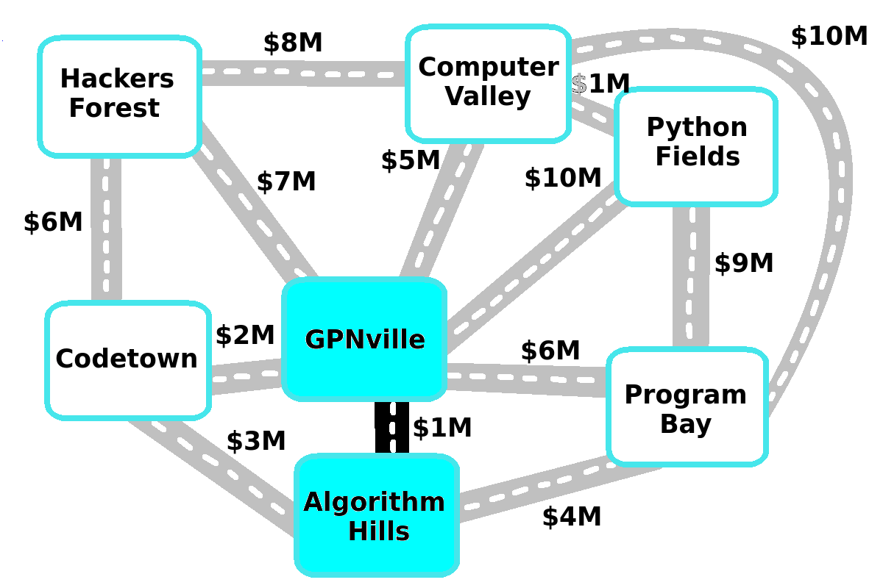
Our Road Building Algorithm
Here’s how:
Find the cheapest road
Build it if it connects 2 areas that couldn’t get to each other before
Repeat until everything connects!
Code
Create HQ

Slide 20
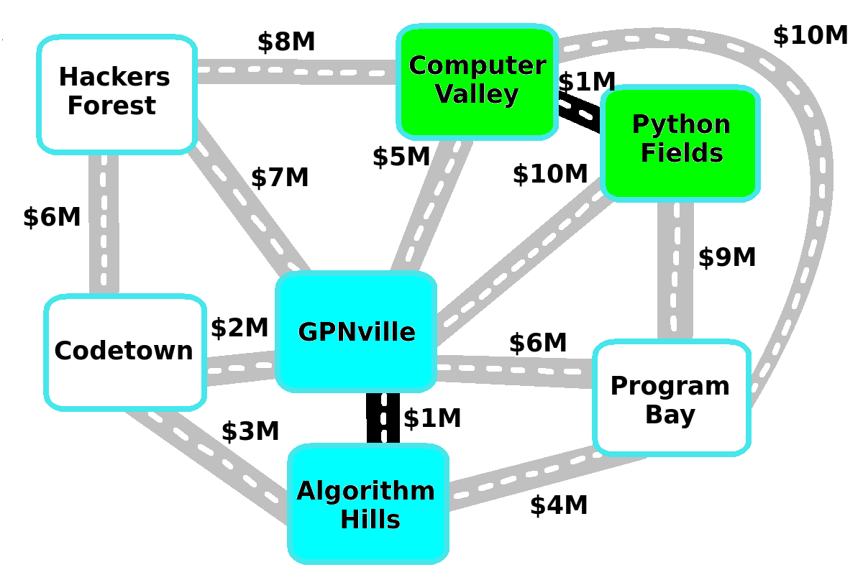
Our Road Building Algorithm
Here’s how:
Find the cheapest road
Build it if it connects 2 areas that couldn’t get to each other before
Repeat until everything connects!
Code
Create HQ

Slide 21
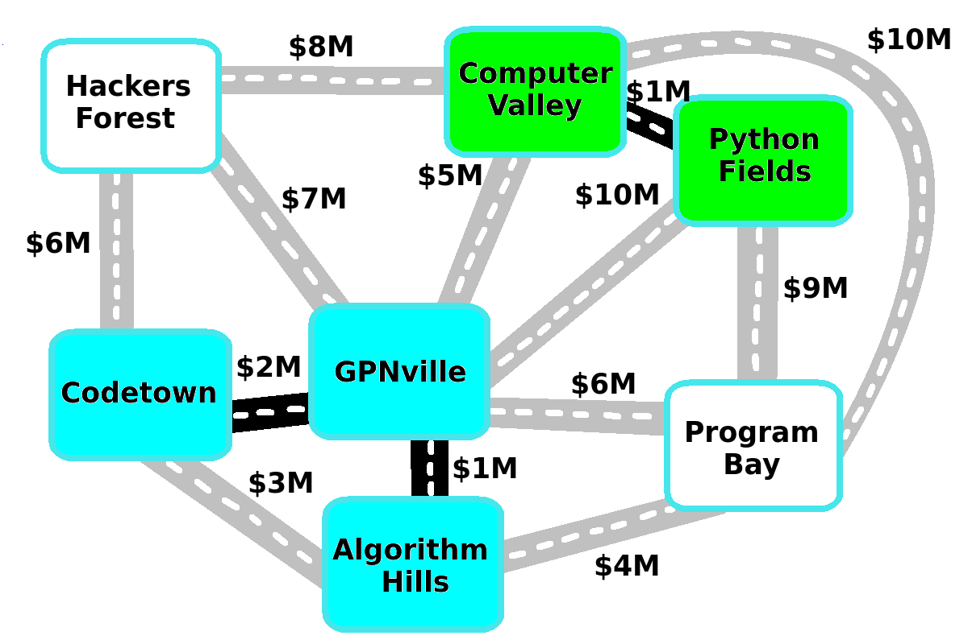
Our Road Building Algorithm
Here’s how:
Find the cheapest road
Build it if it connects 2 areas that couldn’t get to each other before
Repeat until everything connects!
Code
Create HQ
Code
Create HQ

Slide 22
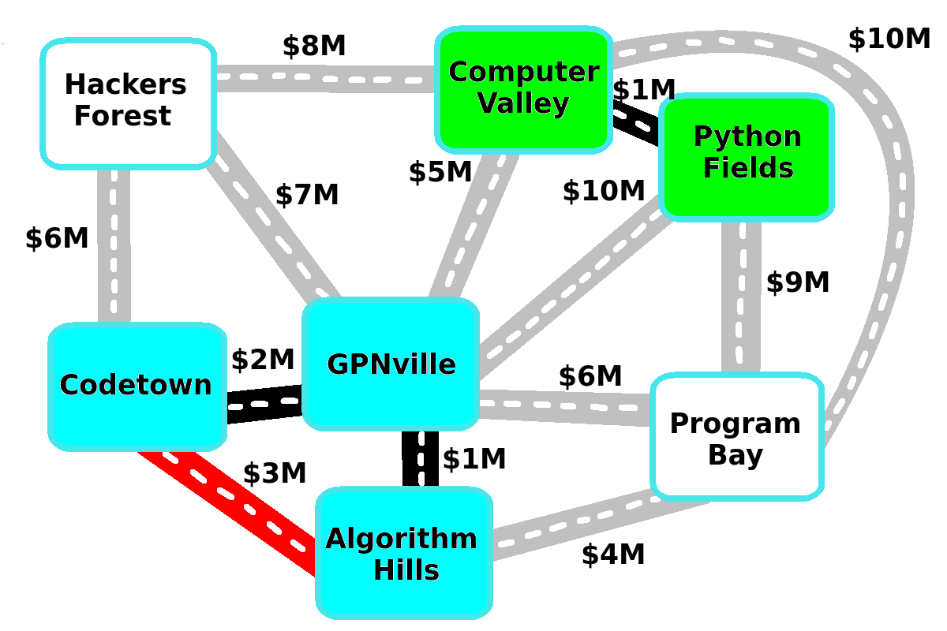
Our Road Building Algorithm
This time building the cheapest road wouldn’t connect any new areas together.
It makes a loop!
That’s a waste of money!
Code
Create HQ
Code
Create HQ
Code
Create HQ

Slide 23
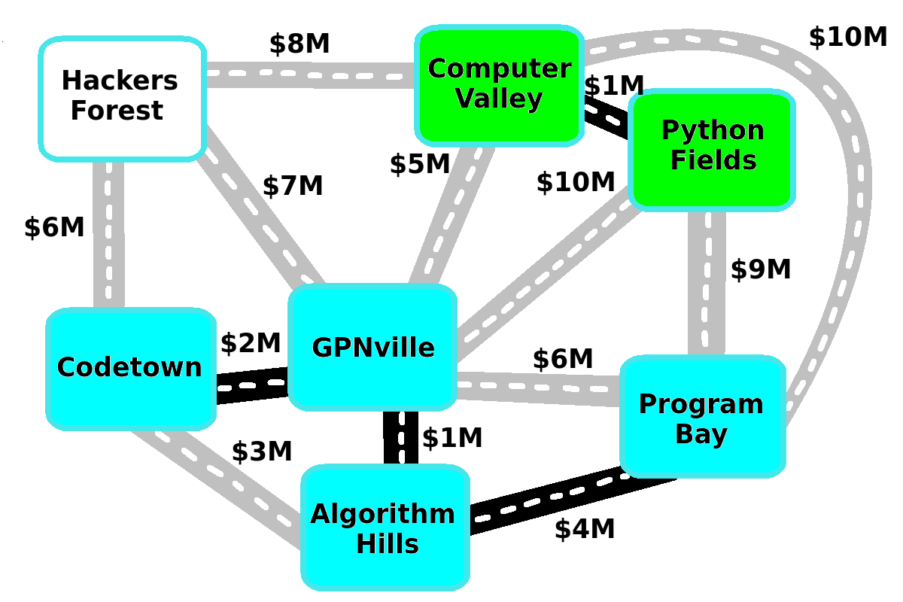
Our Road Building Algorithm
Keep adding useful roads until all the suburbs can get to each other.
There should only be one route to get between any 2 suburbs!
Code
Create HQ

Slide 24
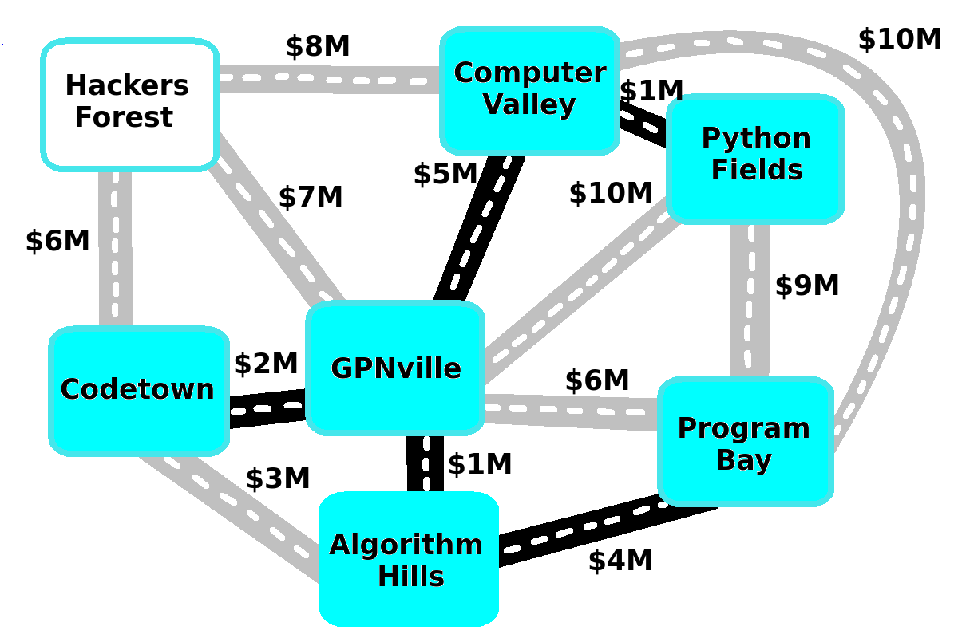
Our Road Building Algorithm
Keep adding useful roads until all the suburbs can get to each other.
There should only be one route to get between any 2 suburbs!
Code
Create HQ

Slide 25
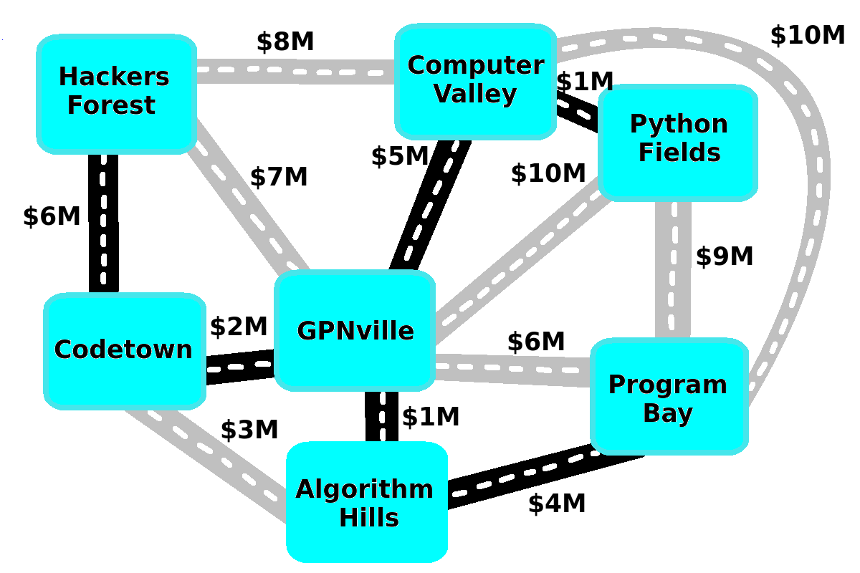
Our Road Building Algorithm
Keep adding useful roads until all the suburbs can get to each other.
There should only be one route to get between any 2 suburbs!
Code
Create HQ

Slide 26
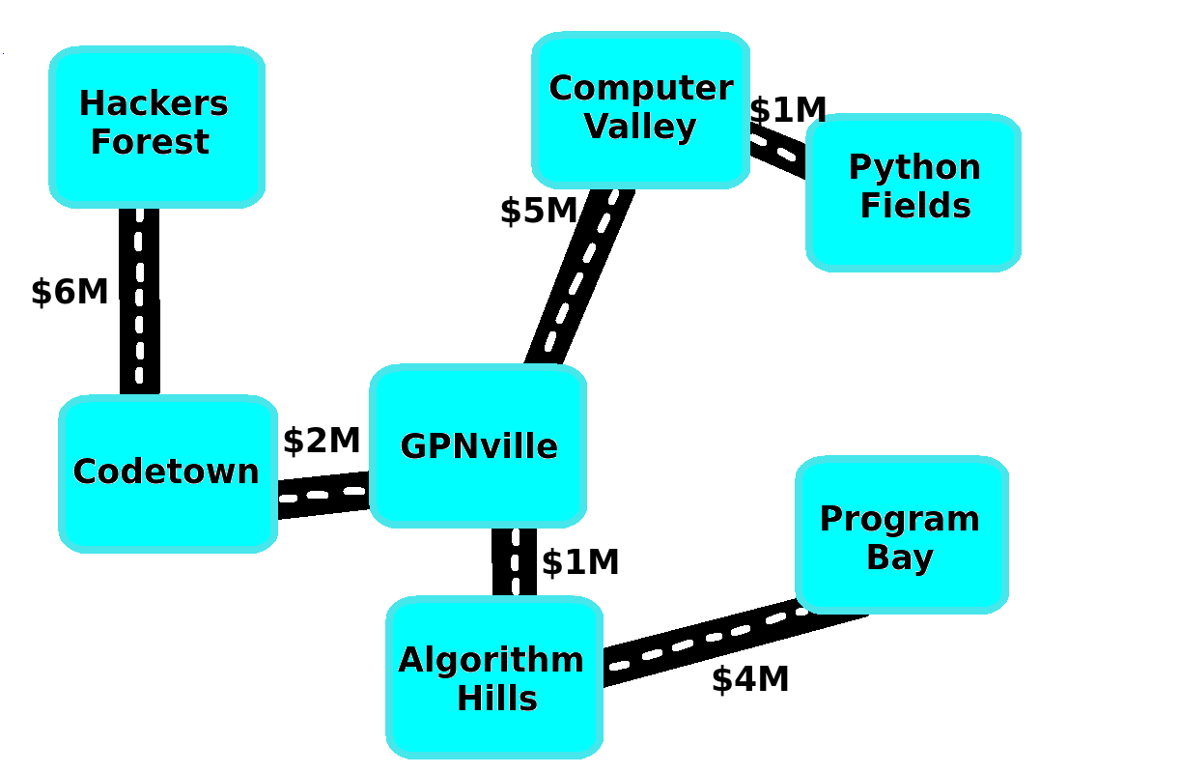
Our Road Building Algorithm
We’re done!
Every suburb is connected
There is only 1 route between any 2 suburbs
There are no loops
We only used the cheapest roads! So it must be the cheapest!
Code
Create HQ

